Slide 1
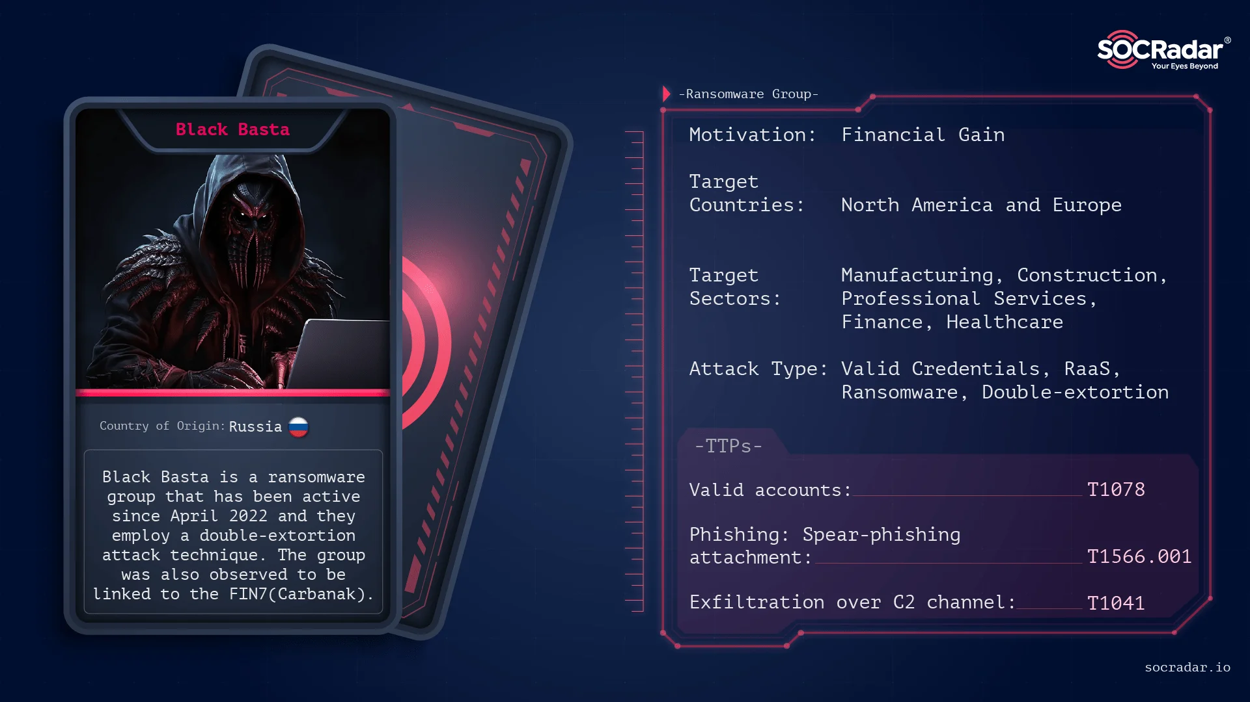

Slide 2
Executive Summary
Type: Ransomware-as-a-service (RaaS) group
First Identified: April 2022
Tactics: Double extortion (encrypting data and threatening to leak if ransom isn't paid)
Impact: Over 500 organizations globally (as of May 2024)
Targets: Businesses and critical infrastructure in North America, Europe, and Australia (12 out of 16 critical sectors, including Healthcare and Public Health)
Ransom: Demands exceeding millions of dollars
Notes:
Black Basta is a ransomware-as-a-service (RaaS) group first identified in April 2022 that employs double extortion tactics. Black Basta encrypts systems and exfiltrates sensitive data. If the ransom is not paid, the group threatens to release the stolen data on their dark web leak site, Basta News. As of May 2024, Black Basta affiliates have impacted over 500 organizations globally. This group targets a wide range of businesses and critical infrastructure in North America, Europe, and Australia. The group has targeted at least 12 of 16 critical infrastructure sectors, including Healthcare and Public Health (HPH).
Background Black Basta was first observed in April 2022, with evidence suggesting development since February 2022. Within its first two weeks, at least 20 victims were posted on its leak site. The group initially targeted large organizations in construction and manufacturing but has also targeted other critical infrastructure, including the health and public health sector.
Some researchers suspect Black Basta may be a rebrand of the Russian-speaking RaaS group Conti or linked to other Russian-speaking cyber threat groups like FIN7 and BlackMatter, due to similar tactics, techniques, and procedures (TTPs). Black Basta is primarily financially motivated and demands ransoms exceeding millions of dollars. Operators have expressed interest in targeting English-speaking countries, suggesting a possible political agenda.

Slide 3
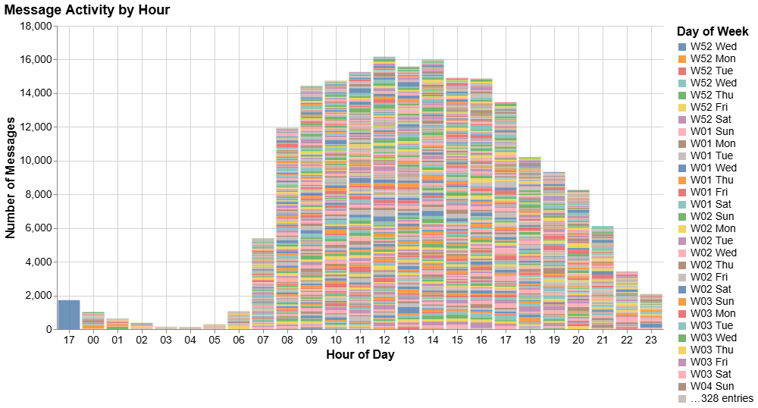
Notes:
In this section, we will analyze activity patterns to understand the operational timing of the Black Basta ransomware group. By examining timestamps in the chat logs, we can identify:Peak activity periods – When the group was most active.
Daily and weekly trends – Whether operations followed a structured schedule.
Time zones and coordination – Insights into the possible locations of key actors.
Operational shifts – Changes in activity over time, indicating internal disruptions or strategic adjustments.

Slide 4
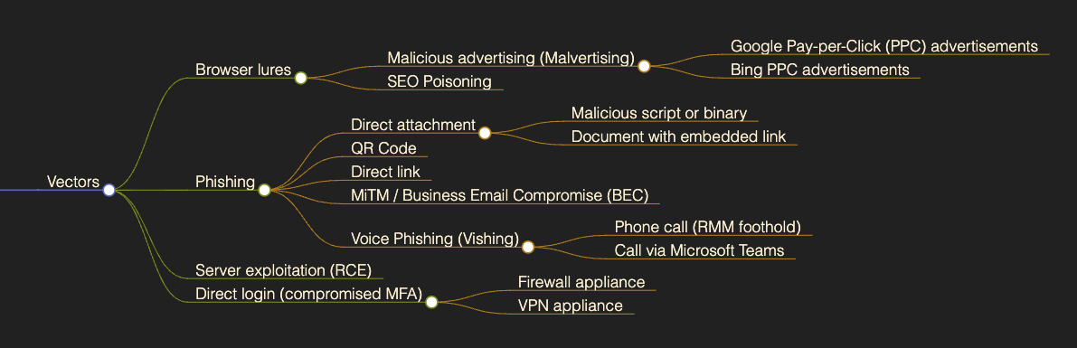
Targeting Delivery
Notes:
https://bencrypted.gitlab.io/posts/8/

Slide 5
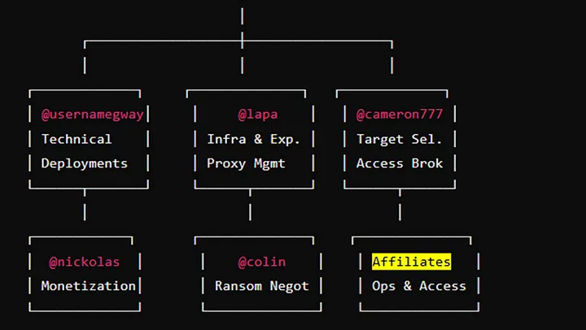

Slide 6
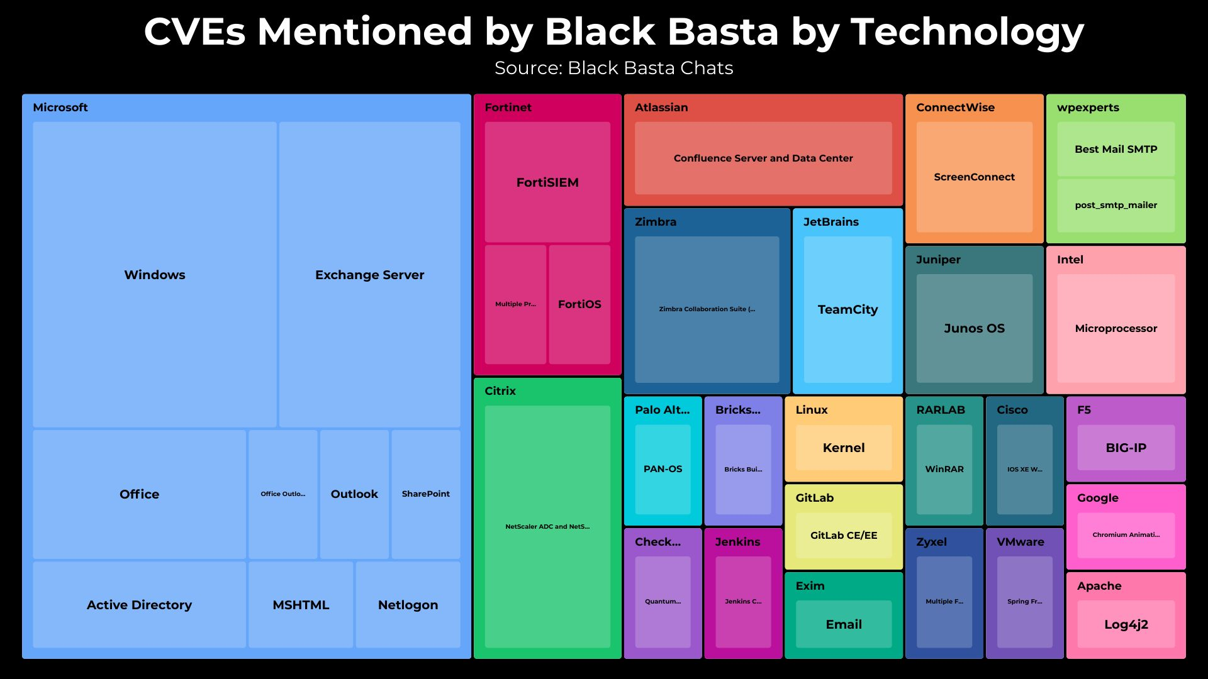

Slide 7
Tactics, Techniques, and Procedures (TTPs)
Initial Access:
Spearphishing: Black Basta affiliates primarily use spear phishing emails to gain initial access.
Exploiting Known Vulnerabilities: Affiliates have exploited ConnectWise vulnerability CVE-2024-1709.
Abusing Valid Credentials: In some instances, affiliates have been observed abusing valid credentials.
Qakbot: Black Basta has been observed using Qakbot during initial access.
Discovery and Execution:
Network Scanning: Black Basta affiliates use tools such as SoftPerfect network scanner (netscan.exe) to conduct network scanning.
Reconnaissance: Affiliates conduct reconnaissance using utilities with innocuous file names (e.g., Intel or Dell) left in the root drive C:.

Slide 8
Tactics, Techniques, and Procedures (TTPs)
Lateral Movement:
Remote Access Tools: Tools like Splashtop, Screen Connect, and Cobalt Strike beacons are used for remote access and lateral movement.
Privilege Escalation: :
Credential Scraping: Black Basta affiliates use credential scraping tools like Mimikatz for privilege escalation.
Other Tools: BITSAdmin and PsExec, along with Remote Desktop Protocol (RDP), are used for lateral movement.
Exploiting Vulnerabilities: Black Basta affiliates have exploited ZeroLogon (CVE-2020-1472), NoPac (CVE-2021-42278 and CVE-2021-42287), and PrintNightmare (CVE-2021-34527) vulnerabilities for local and Windows Active Domain privilege escalation.

Slide 9
Tactics, Techniques, and Procedures (TTPs)
Defense Evasion:
Masquerading: Affiliates use utilities with innocuous file names to evade detection.
Exfiltration and Encryption:
Disabling Security Tools: Black Basta affiliates use PowerShell to disable antivirus products and deploy tools like Backstab to disable endpoint detection and response (EDR) tooling.
Data Exfiltration: RClone is used to facilitate data exfiltration prior to encryption.
Encryption: A ChaCha20 algorithm with an RSA-4096 public key fully encrypt files. A .basta or otherwise random file extension is added to file names.
Inhibiting System Recovery: Affiliates use the vssadmin.exe program to delete volume shadow copies.

Slide 10
Tactics, Techniques, and Procedures (TTPs)
Ransom Demands:
Remote Access Tools: Tools like Splashtop, Screen Connect, and Cobalt Strike beacons are used for remote access and lateral movement.
Toolbox:
Credential Scraping: Black Basta affiliates use credential scraping tools like Mimikatz for privilege escalation.
Other Tools: BITSAdmin and PsExec, along with Remote Desktop Protocol (RDP), are used for lateral movement.
Exploiting Vulnerabilities: Black Basta affiliates have exploited ZeroLogon (CVE-2020-1472), NoPac (CVE-2021-42278 and CVE-2021-42287), and PrintNightmare (CVE-2021-34527) vulnerabilities for local and Windows Active Domain privilege escalation.

Slide 11
Microsoft Teams Phishing: Ransomware Uses Impersonation to Breach Networks
Attack methods :
Attack methods have evolved from overwhelming inboxes with spam to include voice and Teams-based impersonation, each designed to trick users into facilitating access.
Mitigate Threats:
To mitigate these threats, cybersecurity researchers recommend restricting external communication on Teams, configuring strict anti-spam and phishing filters, and enabling logging for Teams activities.
Once access is granted, executables like “AntispamAccount.exe” are deployed, enabling further exploitation with tools like Cobalt Strike or Impacket.
Employees should receive targeted training to recognize suspicious interactions, especially from accounts posing as IT support, and to avoid scanning unverified QR codes.
Notes:
The BlackBasta ransomware group has recently enhanced its social engineering tactics by utilizing Microsoft Teams for initial access, building on past approaches that relied heavily on email and phone impersonation. Previously known for flooding inboxes and posing as IT help desks, the group now contacts users on Teams, Masquerading as corporate IT departments to prompt employees to install remote monitoring and management (RMM) tools like AnyDesk and NetSupport Manager, ultimately setting the stage for ransomware deployment. This new strategy includes crafting fake Entra ID tenants and incorporating QR codes that lead users to malicious sites, increasing the risk of unauthorized network access.
Comprehensive endpoint monitoring is also essential to detect unauthorized RMM tool installations and prevent lateral movement by threat actors.

Slide 12
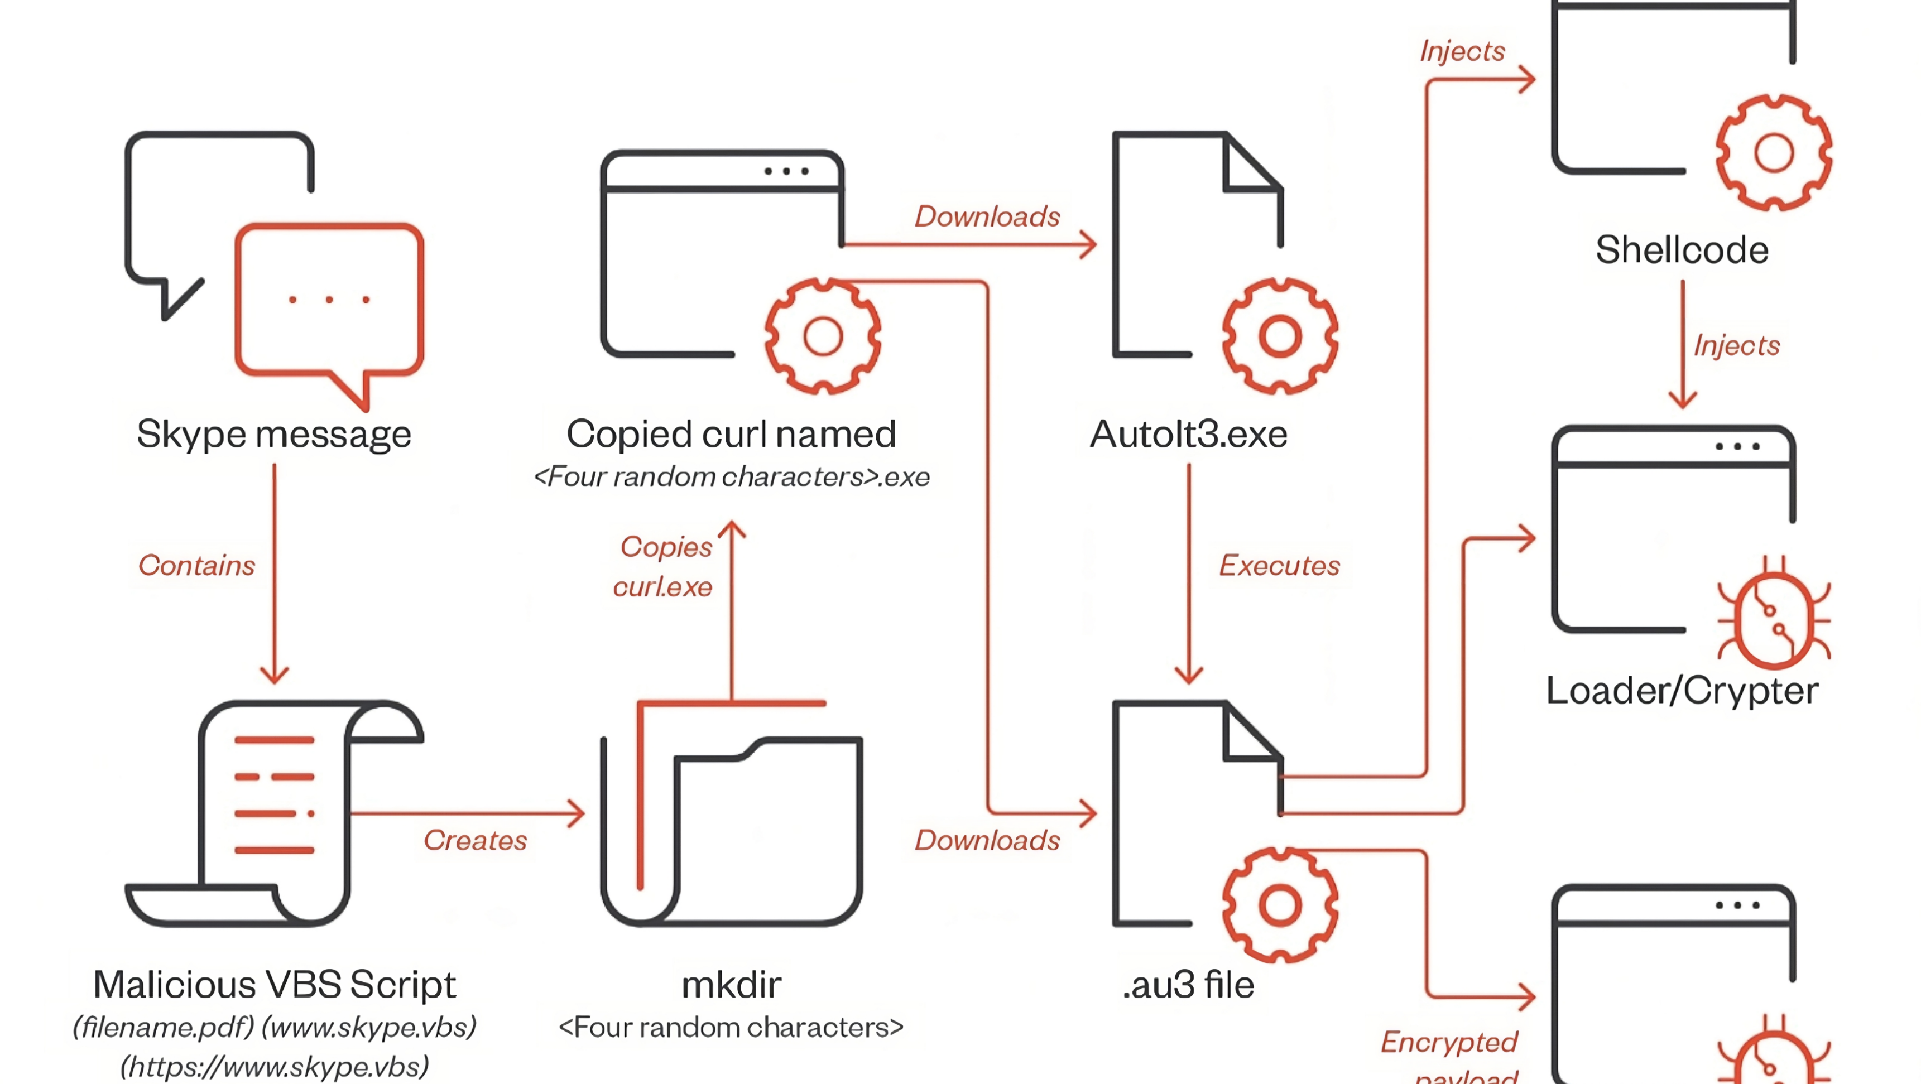

Slide 13
// Detect Black Basta Ransomware Campaign
// Social Engineering Attack via Teams
// https://www.rapid7.com/blog/post/2024/12/04/black-basta-ransomware-campaign-drops-zbot-darkgate-and-custom-malware/
// Exclude Corporate Sharepoint
let CorporateSharepoint = "xxx.sharepoint.com";
CloudAppEvents
| where Application == @"Microsoft Teams"
| where ActionType == @"MessageSent"
| where AccountId contains "@"
| where parse_json(RawEventData)["CommunicationType"] == 'OneOnOne'
| where isnotempty(parse_json(RawEventData)["MessageURLs"])
| where (parse_json(RawEventData)["MessageURLs"]) contains ".sharepoint.com"
// External Teams Tenant sending a sharepoint link to download RMM tools to evade detections
| where (parse_json(RawEventData)["MessageURLs"]) !contains CorporateSharepoint
Notes:
https://medium.com/@simone.kraus/black-basta-playbook-chat-leak-d5036936166d

